Slide 1
Welcome Class CSE of 2020
Lecturer: Prof. Christina Andersson

Slide 2

Welcome Class CSE of 2020
Lecturer: Dr. Hai – BA
Group 8
Discriminant Analysis
HEAD FIRST DESIGN PATTERN
Company Milestone Business Plan

Slide 3




Our Team
Thai Quang Nam 18770
Mai Nguyen Vy 17647
Ha Quach Phu Thanh 18840
Nguyen Khac Hoang 18230

Slide 4
Table of Content and Goals
01
Discriminant Analysis
What is it?
02
Topic Survey
Survey questions and dataset
03
Findings and Conclusions
How could the method help us?

Slide 5
01
Discriminant Analysis
What is it ?

Slide 6
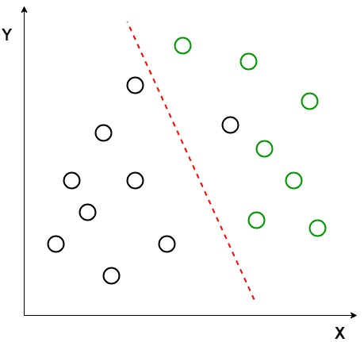
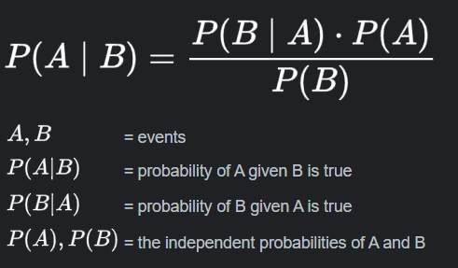
Brief
Bayes’ Theorem
Source: GeeksforGeeks
features

Slide 7
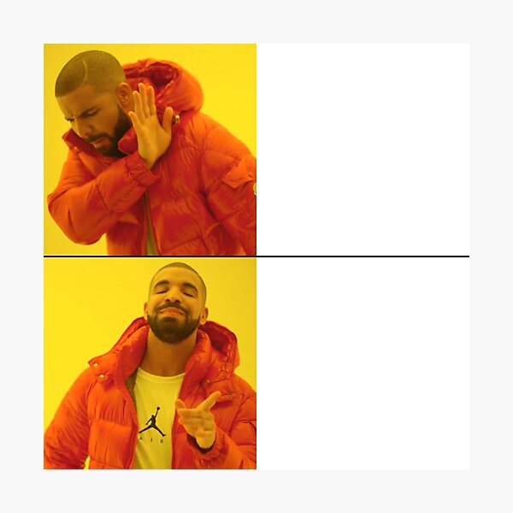


Application
Swiss Notes
Counterfeit

Slide 8
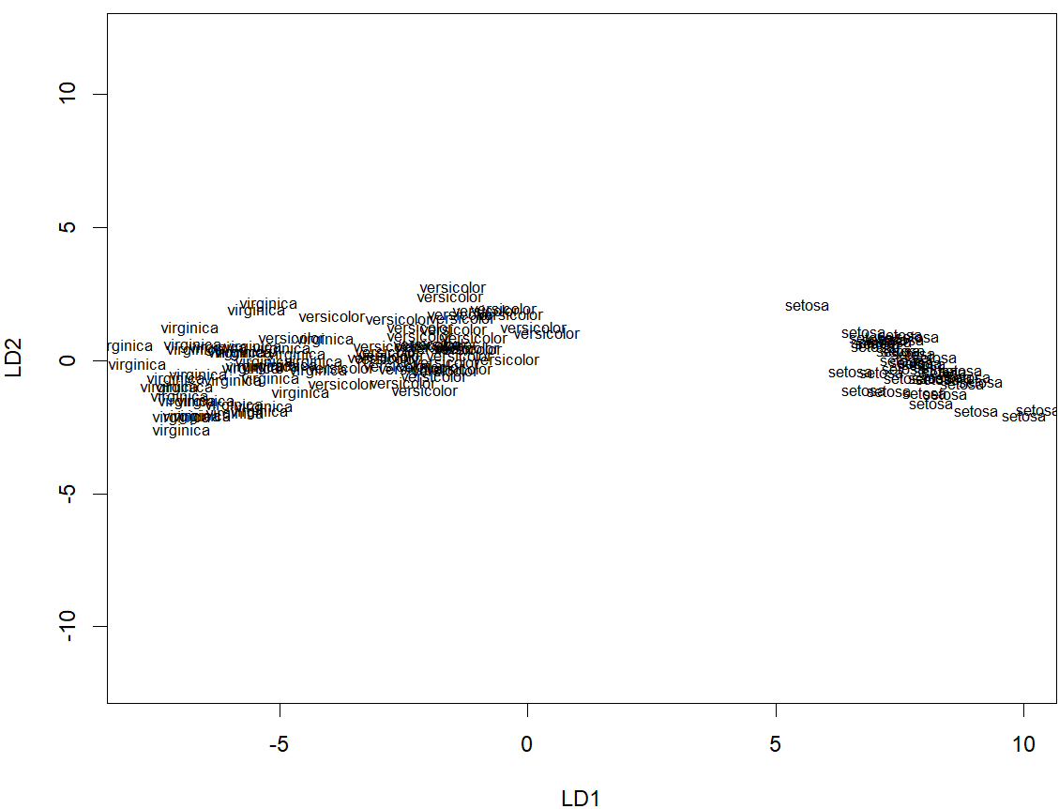
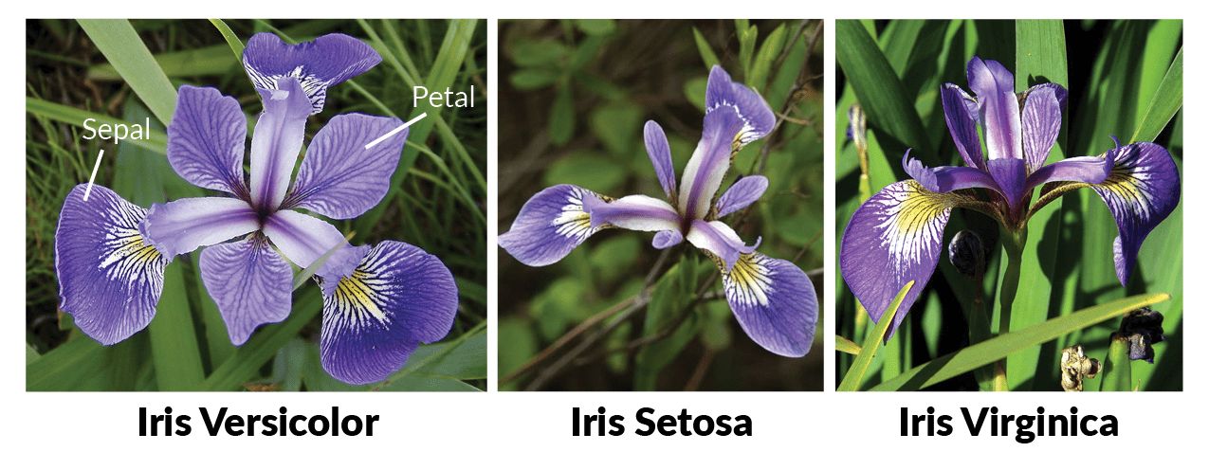
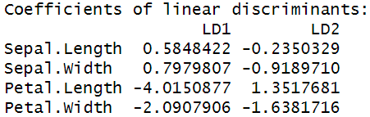
IRIS Example in R
x1: Sedal Length
x2: Sedal Width
x3: Pepal Length
x4: Pepal Width
Predict
y: Species
Setosa
Versicolor
Virginica
Linear Discriminant Analysis
LD1 = 0.58*x1 + 0.79*x2 - 4.01*x3 - 2.09*x4
LD2 = -0.23*x1 - 0.91*x2 + 1.35*x3 - 1.63*x4

Slide 9
Strengths
Multivariate Analysis
Diverse range of classes
Dimension Reduction
Data Transformation
Original data -> Training and Testing data -> Better Prediction

Slide 10
Weaknesses
Outliers in Data
Overly influenced by extreme value
Overfitting with Small Sample Sizes
Noisy data/random fluctuations

Slide 11
Types of Discriminant Analysis
Linear Discriminant Analysis
Quadratic Discriminant Analysis
Regularized Discriminant Analysis
Multinomial Discriminant Analysis
Fisher’s Linear Discriminant
Flexible Discriminant Analysis
Canonical Discriminant Analysis

Slide 12
02
The Survey and Dataset
Survey questions and dataset

Slide 13
Can discriminant analysis predict student performance based on their lifestyles and study habits?
Notes:
Why?
DA is great for classifying. Here the output is 2 classes, high and low
Curious about lifestyles of elite students -> learn from them

Slide 14
Survey Questions
What is your GPA (German scale) ?
What is your most recent IELTS score?
How often do you attend lectures and classes? (percent)
How likely do you study in a group? (percent)
On average, how many hours a day do you sleep? (hours/day)
At what time of the day do you usually study outside of class?
On average, how many hours a day do you spend doing your academic homework? (hours/day)
On average, how many hours a day do you spend doing extracurricular activities (hours/day)
On average, how many hours a day do you spend doing leisure activities? (hours/day)
What is the distance (kilometers) from your home to your campus? (0 km if you stay on campus)
GPA
Ielts_Score
Attendance
Groupstudy_Likelyness
Sleep_Duration
Study_Hour
Selfstudy_Duration
Extracurricular_Duration
Leisure_Duration
Distance
Notes:
to Bachelors Ss VGU year 2,3,4, send 3 times
79 responses
change column names

Slide 15
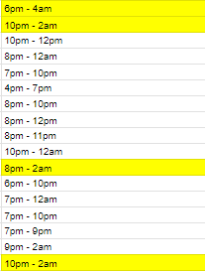
DATA PREPROCESSING
Remove Study_Hours

Slide 16
Outlier Tuples

Slide 17
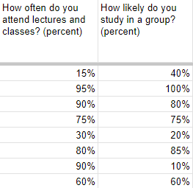
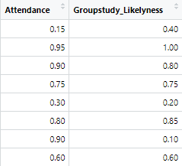
Data types Re-formatting
Notes:
string into floats (numeric in R)

Slide 18
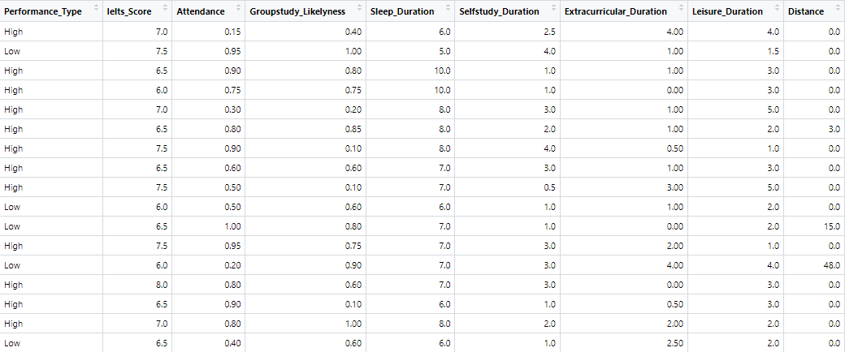
Final Dataset
Notes:
How we get to Performance Type?
target var? predictor var?

Slide 19
CHARACTERISTICS AND VISUALIZATION
Ielts_Score
Attendance
Groupstudy_Likeliness
Selfstudy_Duration
Extracurricular_Duration
Leisure_Duration
Distance
Sleep_Duration
Performance_Type

Slide 20
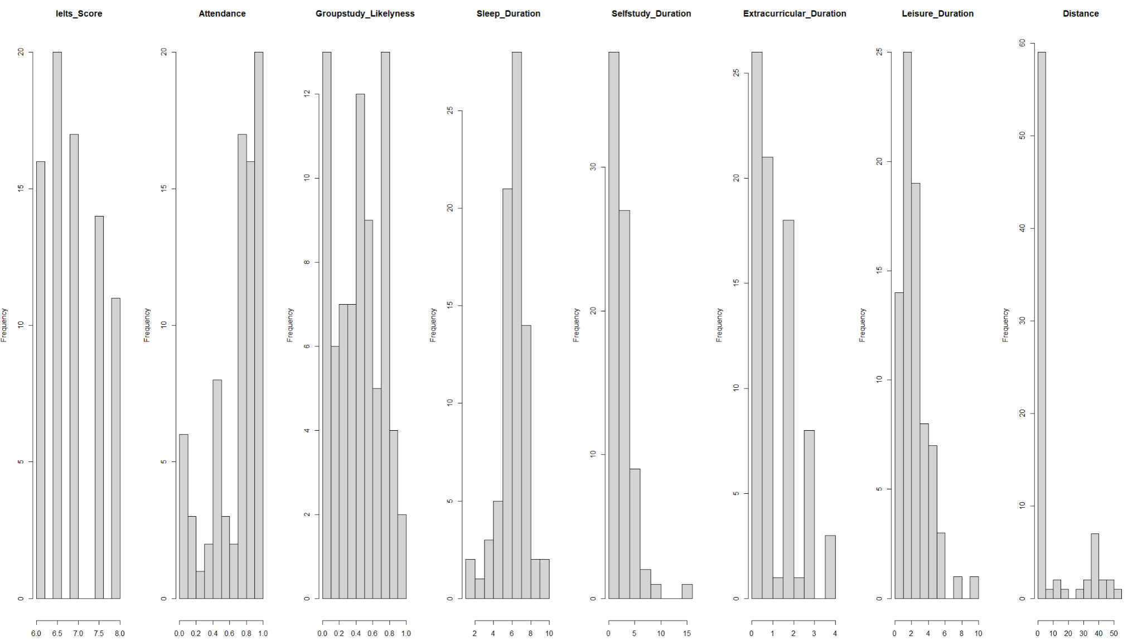
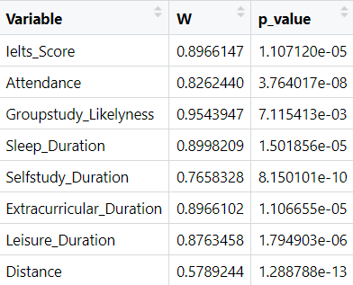
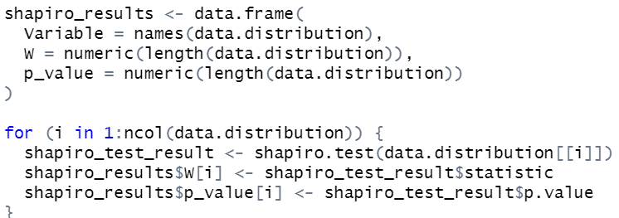
Data Distribution
w: test statistic for normality
p-value: test statistic < 0.05
Shapiro-Wilk Test

Slide 21
Data Distribution
Normality Assumption Violation -> Parametric methods
Discriminant Analysis
Quadratic Discriminant Analysis (QDA)
Linear Discriminant Analysis (LDA)

Slide 22
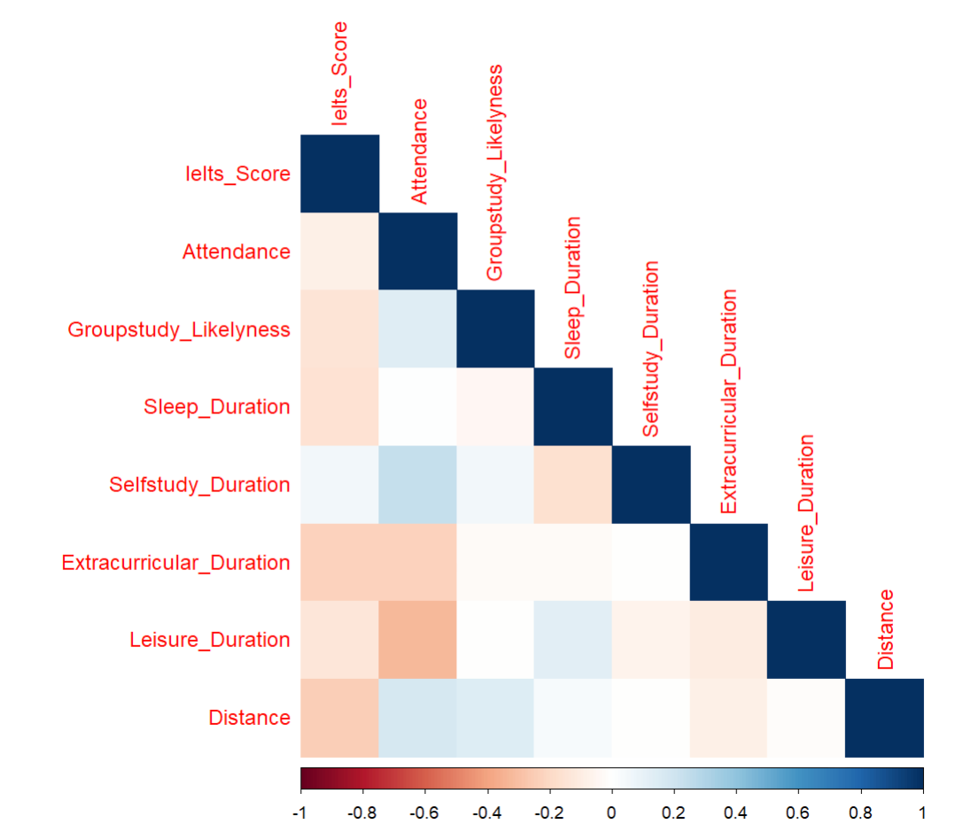
Correlation and Collinearity
Correlation testing methods: Pearson - Spearman - Kendall
Spearman

Slide 23
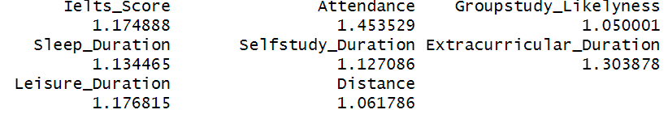
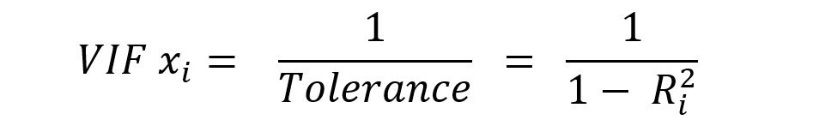
Correlation and Collinearity
The Variance Inflation Factor (VIF)
VIF = 1: No collinearity
VIF >= 5: High collinearity
VIF >= 10: Severe collinearity

Slide 24
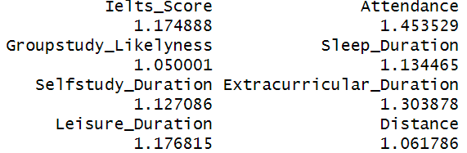
Summary
Normality
Correlation
Collinearity

Slide 25
03
Findings and Conclusions
How does the method help us?

Slide 26
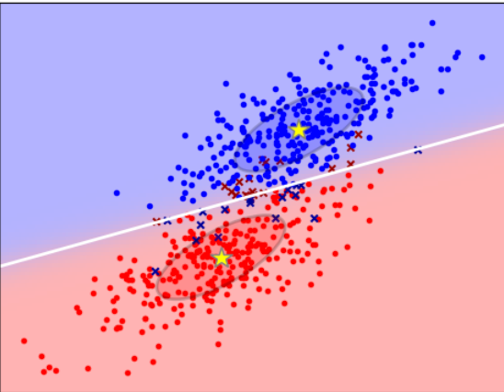
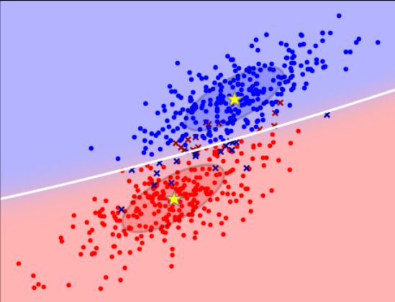
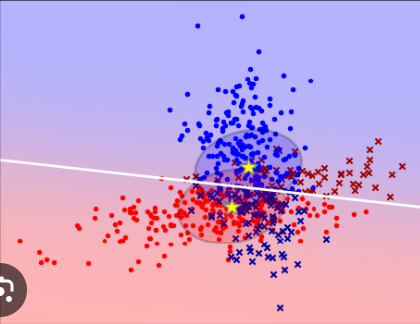
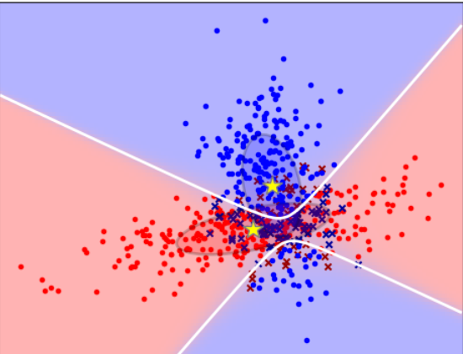
Fixed covariance
Varying covariance
LDA
QDA
Quadratic DA v.s Linear DA

Slide 27
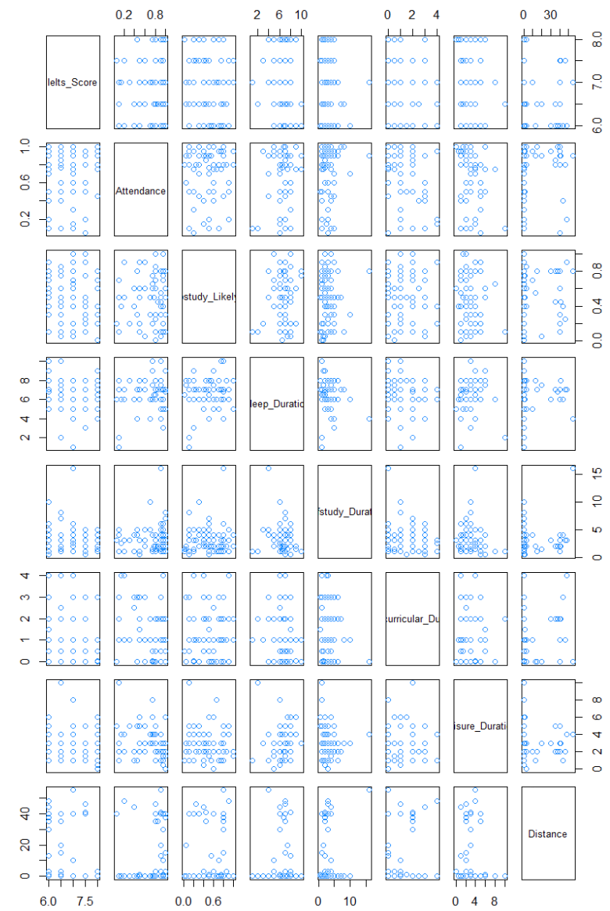
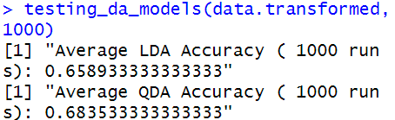
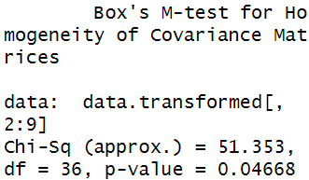
QDA v.s LDA testing
Visual Inspection
Performance test
Box’s M test
QDA performs better on average than LDA
Reject the null hypothesis: the covariance matrices across the 2 classes are equal
the covariance matrices not equal

Slide 28
QDA v.s LDA testing
Evidence: the covariance matrices of 2 classes are not equal
QDA performs better than LDA
Quadratic Discriminant Analysis (QDA)

Slide 29
Our Experiment
Is Lifestyle truly affecting our
academic performance?
5 main steps
Normalize data
Partition data (train/test)
Train QDA model
Run prediction test
Visualize the model

Slide 30
True Value
Z Score
Enables to compare different predictor variable values by scaling the value
Normalize data
Partition data (train/test)
Train QDA model
Run prediction test
Visualize the model

Slide 31
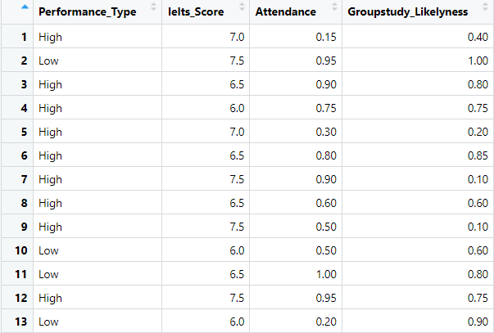
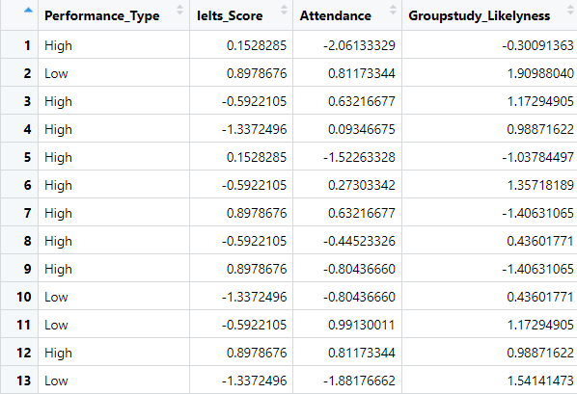
True Value
Z Score
Normalize data
Partition data (train/test)
Train QDA model
Run prediction test
Visualize the model

Slide 32
Dataset (100%)
Train data (80%)
Test data (20%)
random
To train the QDA model
(generate suitable algo)
To test the QDA model (the accuracy of predicting)
Normalize data
Partition data (train/test)
Train QDA model
Run prediction test
Visualize the model

Slide 33
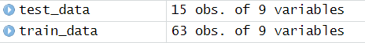
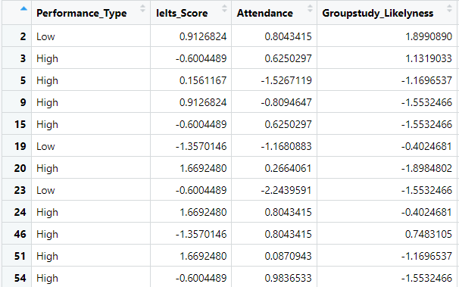
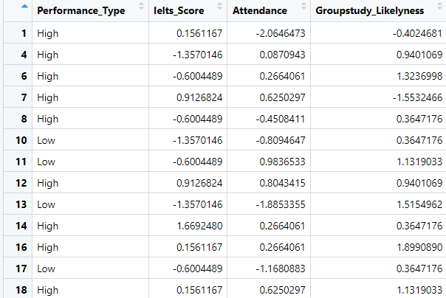
Train data (80%)
Test data (20%)
Normalize data
Partition data (train/test)
Train QDA model
Run prediction test
Visualize the model

Slide 34
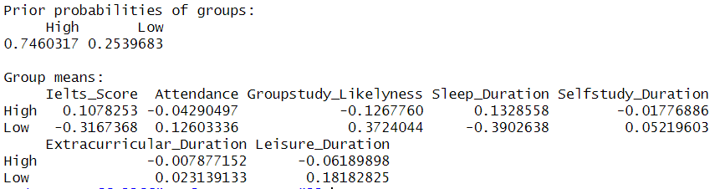
Training the model
The model
Normalize data
Partition data (train/test)
Train QDA model
Run prediction test
Visualize the model

Slide 35
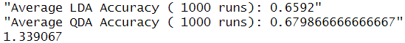
Calculate accuracy for each run (put the test data into the model)
Result
Store all accuracy for all run in a array
Calculate the mean of the accuracy array (total)
Normalize data
Partition data (train/test)
Train QDA model
Run prediction test
Visualize the model

Slide 36
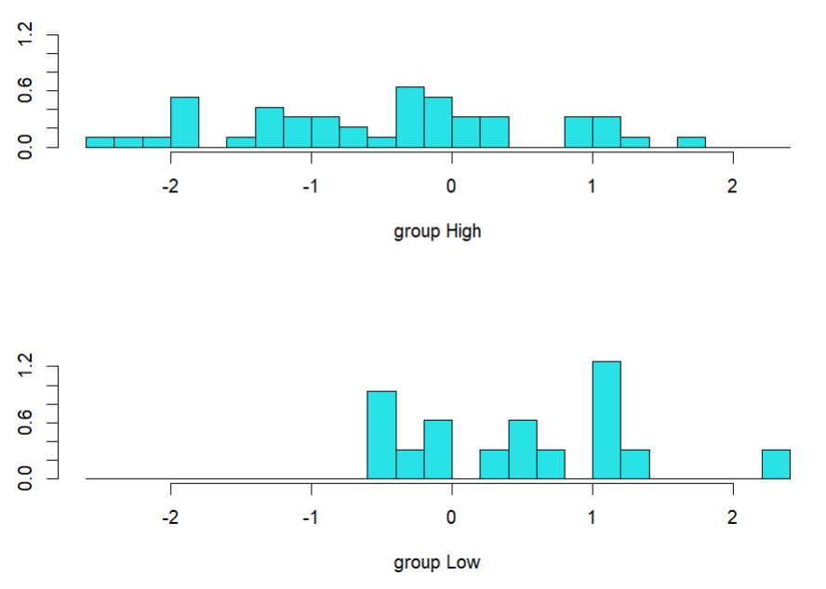

LDA
QDA
There is not a way to visualize in R yet
Normalize data
Partition data (train/test)
Train QDA model
Run prediction test
Visualize the model

Slide 37
Interesting findings
Will the model’s accuracy increase if we remove some predictor variables?

Slide 38
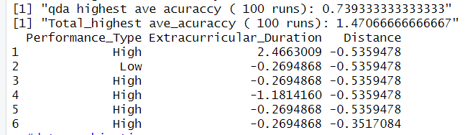
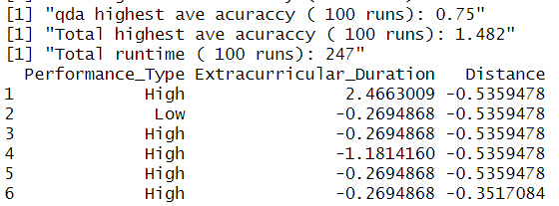
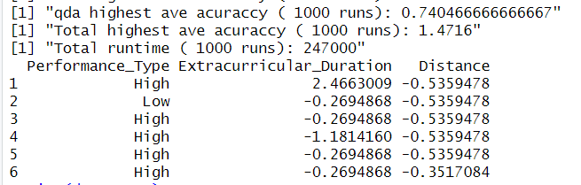
Interesting finding
Create all combination of the chosen column into a list of dataframe (270 combinations)
Run the same QDA test of each dataframe
Extract data from data frame has the highest qda ave accuracy

Slide 39
Conclusion
Discriminant analysis provide us the evidence that lifestyles might be able to predict academic performances with at least 65% accuracy
Extracurricular activities and distance from campus seem to be the biggest factors in our current dataset with at least 74% accuracy
A bigger dataset from more students or universities with diverse data is needed for QDA before drawing a more conclusive result

Slide 40
Thanks for listening
Do you have any questions?
Contact us at: 18840@student.vgu.edu.vn
18770 @student.vgu.edu.vn
18230@student.vgu.edu.vn
17647@student.vgu.edu.vn

